Slide 1
Gentle Introduction to Machine Learning
CII – Analytics and R Workshop
Introduction

Slide 2
Contents
Machine Learning
Applications
Supervised Learning
Unsupervised Learning
Ensemble Learning
ML at scale
References

Slide 3
Machine Learning
Tom M. Mitchell’s 1997 definition:
“A computer program is said to learn from experience E with respect to some class of tasks T and performance measure P, if its performance at tasks in T, as measured by P, improves with experience E.”

Slide 4
Traditional Programming vs ML
Data
Computer
Output
Program
Traditional Programming
Computer
Data
Program
Output
Machine Learning

Slide 5
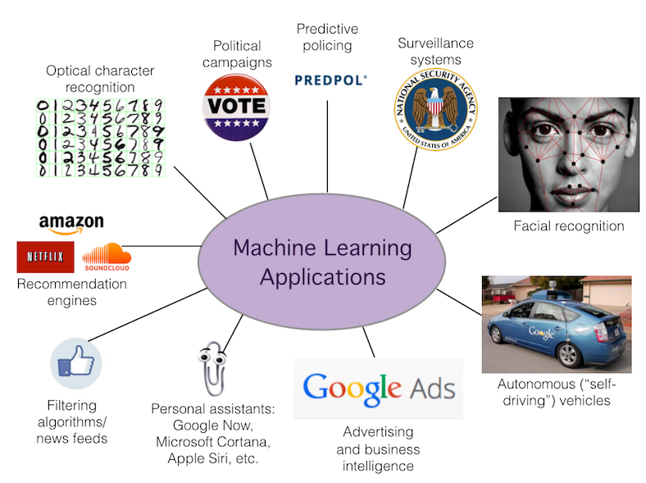
Applications
Web search
Computational biology
Finance
E-commerce
Space exploration
Robotics
Information extraction
Social networks
Image/Speech Recognition
[Your favorite area]

Slide 6
Machine Learning Tasks
Supervised Learning | Unsupervised Learning | Reinforcement Learning
The computer is presented with example inputs and their desired outputs, given by a "teacher", and the goal is to learn a general rule that maps inputs to outputs. | No labels are given to the learning algorithm, leaving it on its own to find structure in its input. Unsupervised learning can be a goal in itself (discovering hidden patterns in data) or a means towards an end (feature learning). | A computer program interacts with a dynamic environment in which it must perform a certain goal (such as driving a vehicle or playing a game against an opponent). The program is provided feedback in terms of rewards and punishments as it navigates its problem space.
Credits: https://en.wikipedia.org/wiki/Machine_learning

Slide 7
Machine Learning Techniques
Supervised
Unsupervised
Reinforcement
Regression
Decision Trees
Random Forests
Clustering
K-Means
Dimensionality Analysis
SVD
PCA
Actor-critic Learning
Dynamic Programming
Model/Model-free approaches
Policy Gradient Methods
Continuous
Classification
Logistic Regression
SVM
Neural Nets
Association Analysis
Apriori
FP-Growth
Hidden Markov Model
Markov Decision Process
states
actions
Policy based approach
Value based approach
Categorical

Slide 8
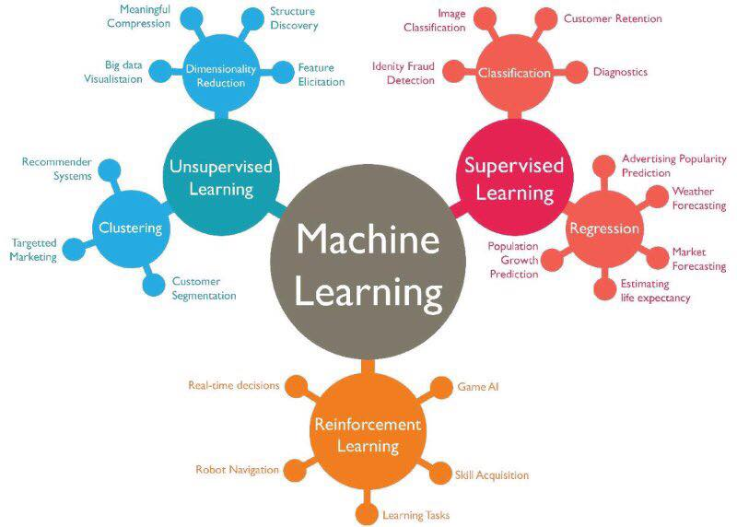
Machine Learning Algorithms
Linear Regression
Logistic Regression
Decision Tree
SVM
Naive Bayes
KNN
K-Means
Random Forest
Dimensionality Reduction Algorithms
Gradient Boost & Adaboost

Slide 9
Performance metrics
Evaluation
Optimization
Accuracy
Precision and recall
Squared error
Likelihood
Posterior probability
Cost / Utility
Margin
Entropy
K-L divergence
Etc.
Combinatorial optimization
E.g.: Greedy search
Convex optimization
E.g.: Gradient descent
Constrained optimization
E.g.: Linear programming

Slide 10
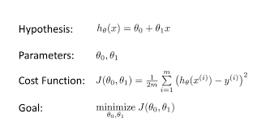
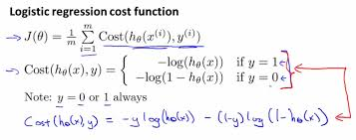
Performance Metrics: Examples

Slide 11
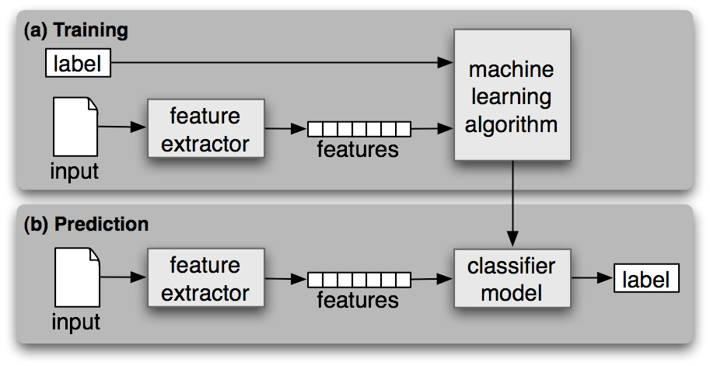
ML workflow

Slide 12
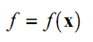
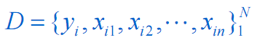
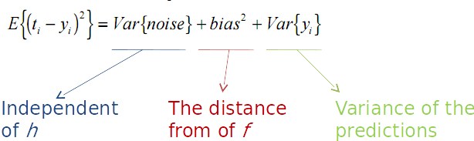
Supervised Learning
We want to approximate a function,
Given examples:
Find a function h among a fixed subclass of functions for which the error E(h) is minimal,

Slide 13
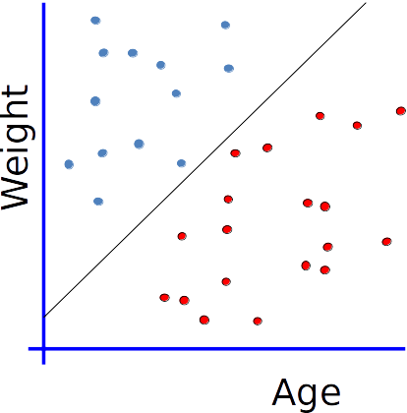
Linear classifier
How would you classify this data?

Slide 14
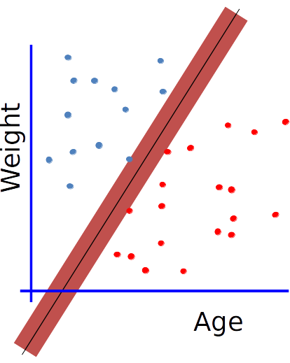
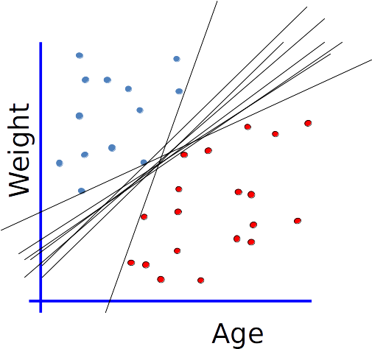
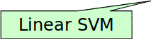
Maximum Margin

Slide 15
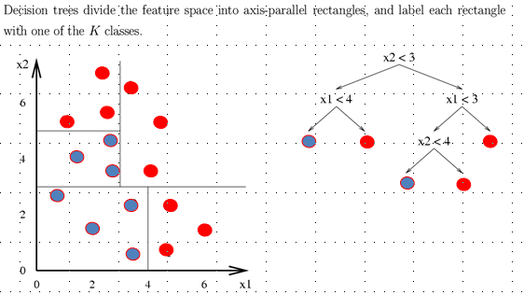
Decision Tree
A flow-chart like tree structure
Internal node or decision stump denotes a comparison on an attribute
Branch represents an outcome of the comparison
Leaf nodes represent class labels or class distribution

Slide 16
Unsupervised Learning
Unsupervised learning is a type of machine learning algorithm used to draw inferences from datasets consisting of input data without labeled responses. The most common unsupervised learning method is cluster analysis, which is used for exploratory data analysis to find hidden patterns or grouping in data.

Slide 17

K-Means Clustering
Partition n observations into k clusters in which each observation belongs to the cluster with the nearest mean, serving as a prototype of the cluster.

Slide 18
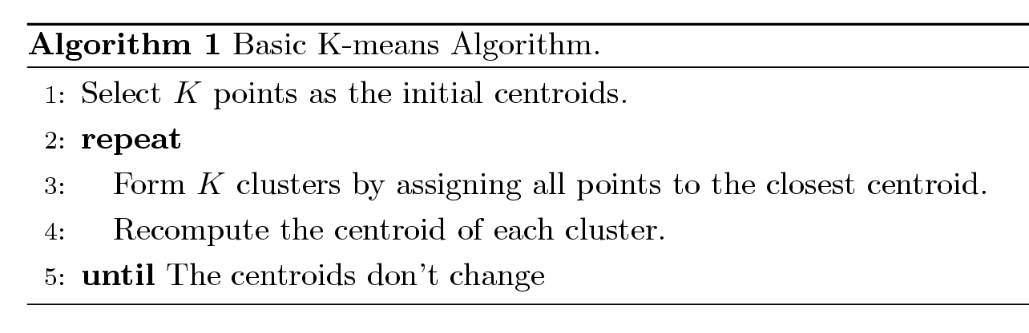
K-Means Algorithm
Partition clustering approach
Each cluster is associated with a centroid (center point)
Each point is assigned to the cluster with the closest centroid
Number of clusters, K, must be specified
The basic algorithm is very simple

Slide 19
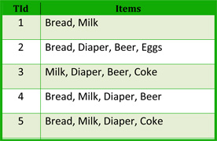
Association Rules Learning
Basket analysis:
P (Y | X ) : probability that somebody who buys X also buys Y where X and Y are products/services.
Example: P ( milk| bread ) = 0.75
Apriori Algorithm

Slide 20
Ensemble Learning
Ensemble Classification
Aggregation of predictions of multiple classifiers with the goal of improving accuracy.
Strategies
Boosting
Make examples currently misclassified more important (or less, in some cases).
Bagging
Use different samples or attributes of the examples to generate diverse classifiers.

Slide 21
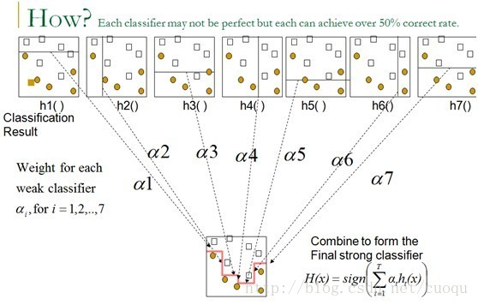
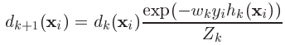
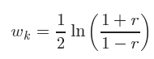
Boosting: AdaBoost
Initialize weights
2. Construct a classifier. Compute the error.
3. Update the weights, and repeat 2.
4. Finally sum the hypothesis.

Slide 22
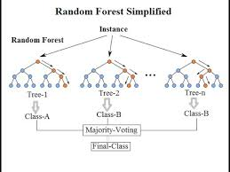
Bagging: Random Forests
Grow n different decision trees
Pick a random subset S of the training set.
Grow a full tree (no pruning).
Use d << D random attributes
Compute Gain based on S.
Repeat for 1 to n
Given a new data X
Predict using all the each of the tree Ti
Use majority voting to predict class

Slide 23
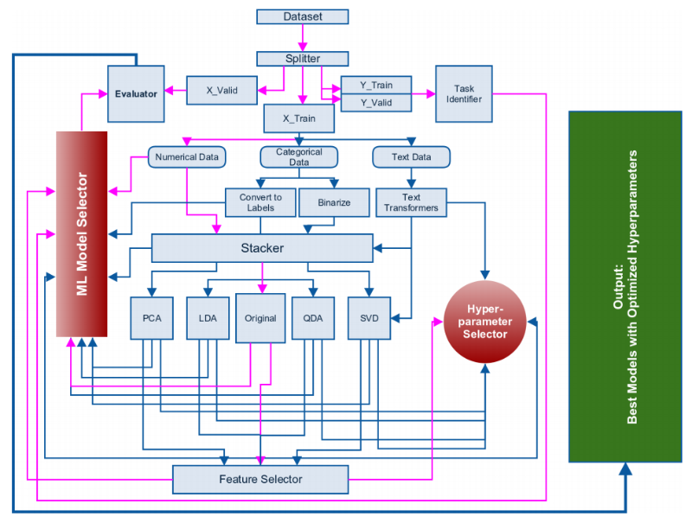
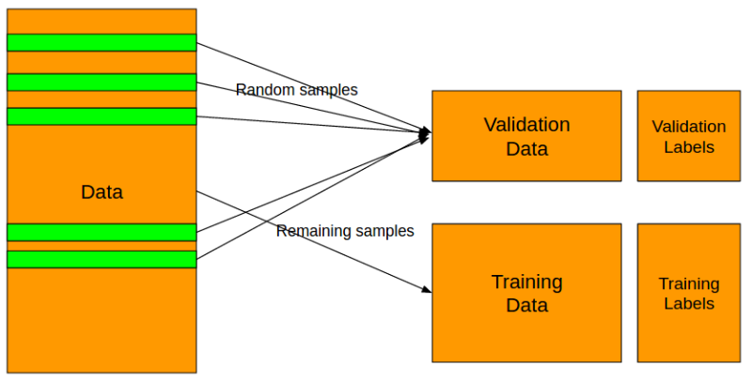
ML workflow
Credits: http://blog.kaggle.com/2016/07/21/approaching-almost-any-machine-learning-problem-abhishek-thakur/

Slide 24

Machine Learning Cheat-Sheet

Slide 25
Conclusions
Machine Learning is a vast field.
Plethora of toolsets are available to get started.
Can be applied to a huge range of applications.
Handling Big Data requires a different framework.
Crucial to identify the problem and selecting the right approaches.

Slide 26
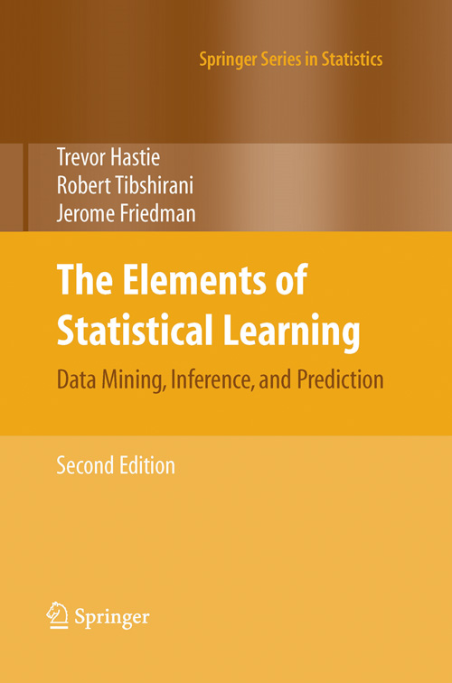
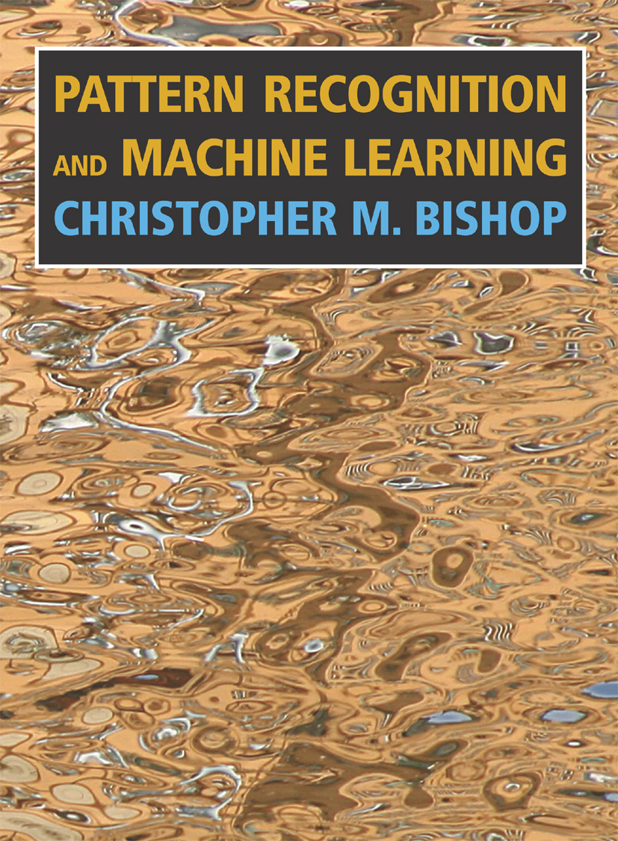
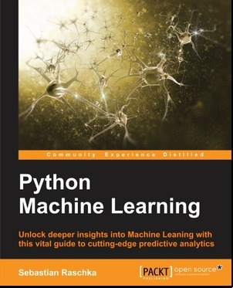
References

Slide 27
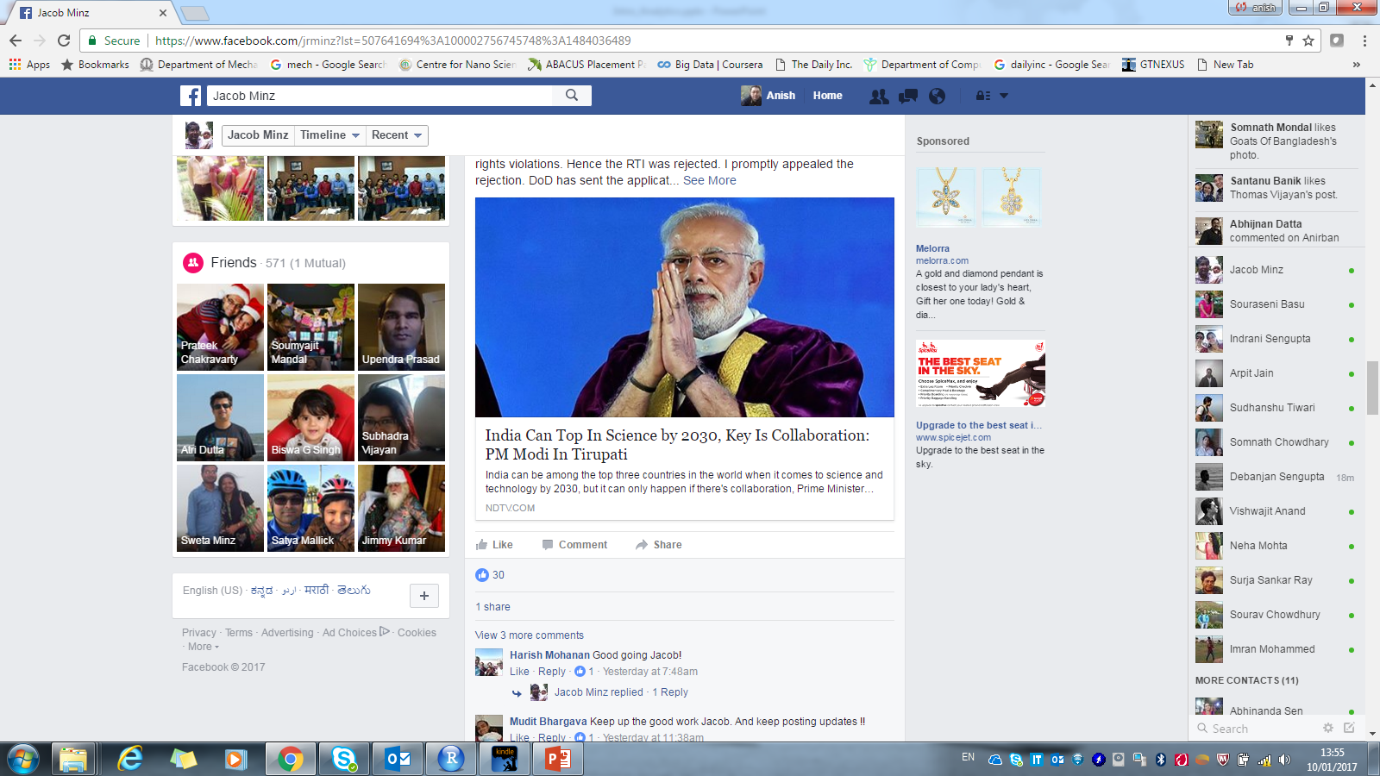
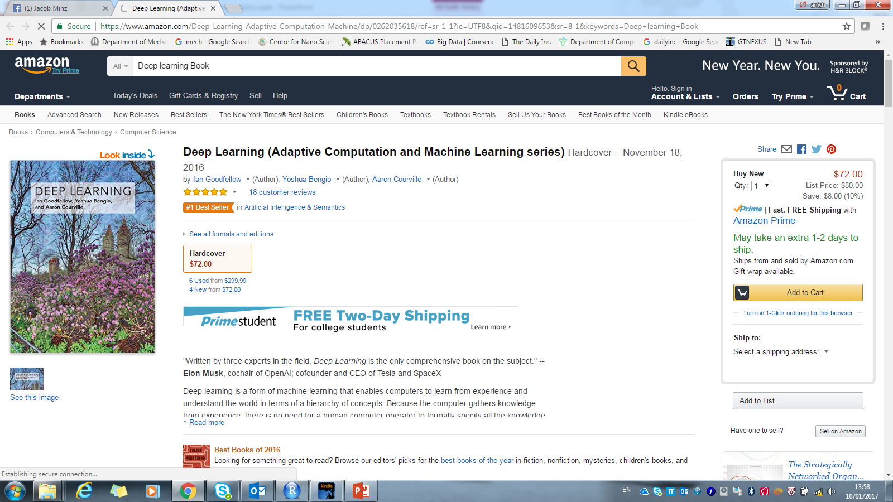
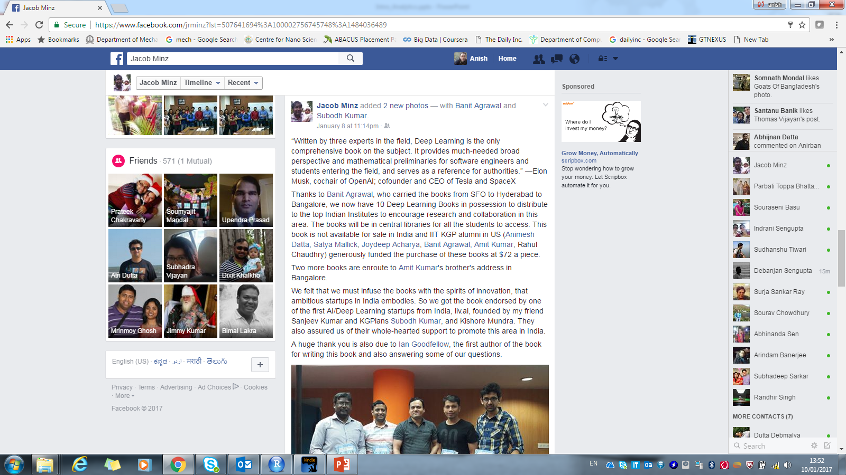
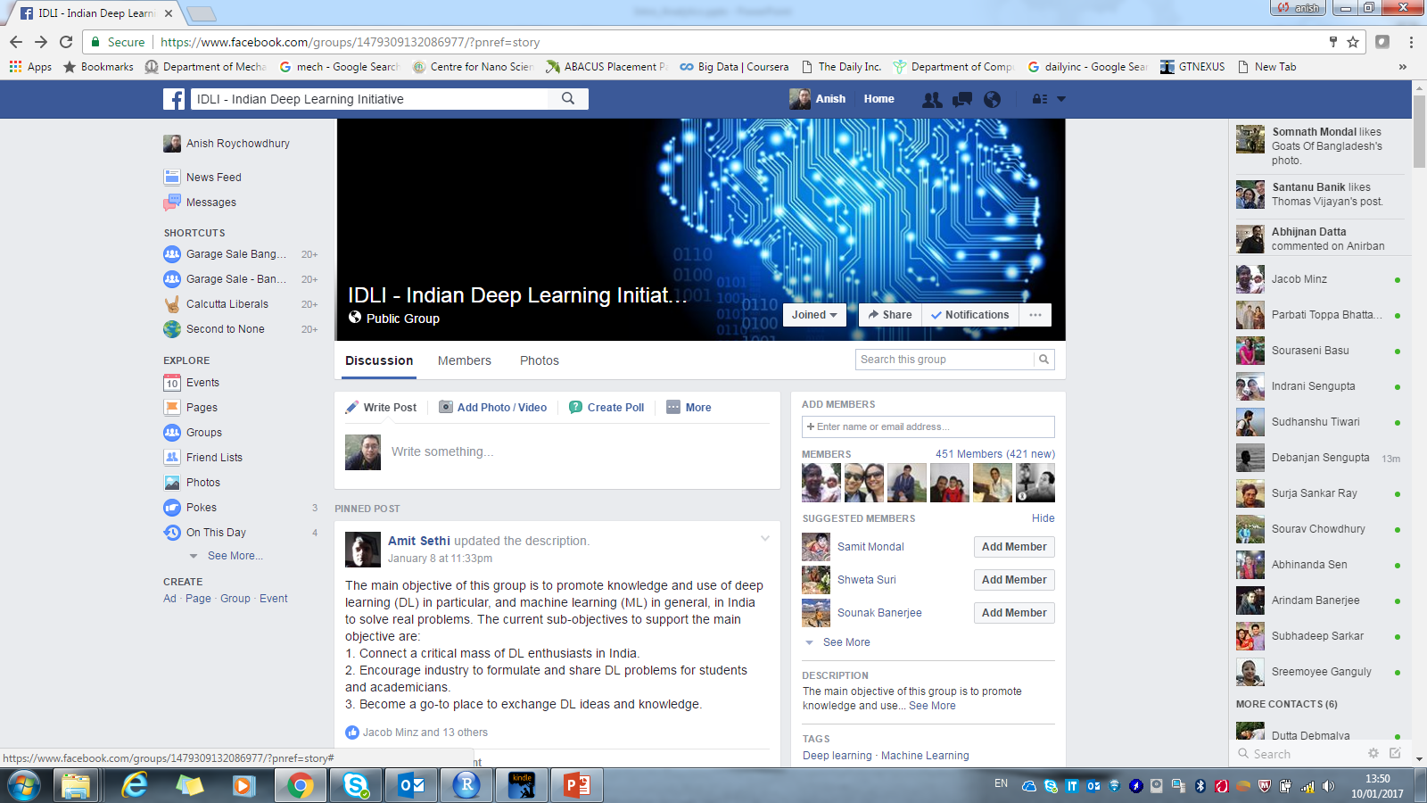
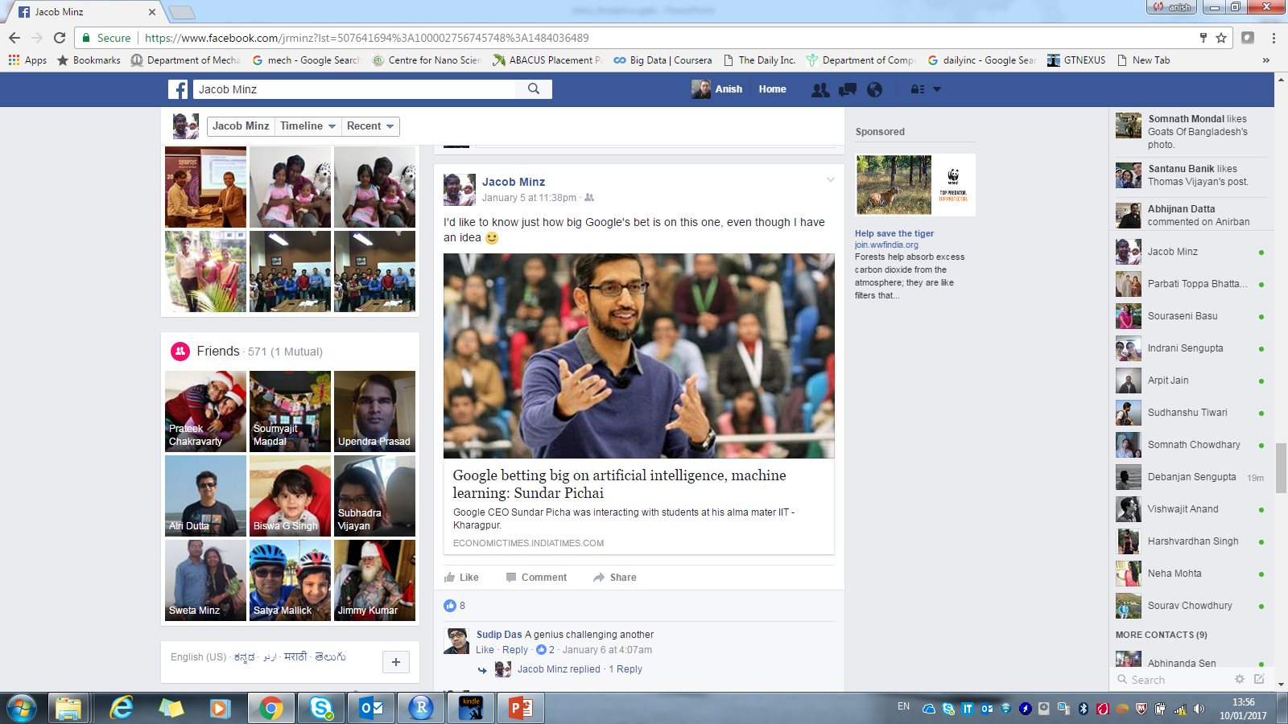
Can we afford to wait and watch ? Not Anymore…
The time to act is now!
Deep
Learning

